Slide 1


Machine Learning: EDA, Data Mining, Time Series Forecast and Knime Analytics
This presentation outlines the use of machine learning techniques for analyzing and forecasting Gross Domestic Product (GDP). We will explore various methodologies, from data mining and exploratory data analysis (EDA and advanced time series modeling with Meta Prophet and KNIME Analytics Platform. Our goal is to provide a comprehensive understanding of how machine learning can be applied to economic forecasting, offering valuable insights for policymakers and financial analysts.

Slide 2

Team Members
Leader: Arijit Dutta (22/ECE/054)
Members:
Arijit Dutta (22/ECE/054) Arighna Jha(22/ECE/053) Brijit Maity(22/CSE-CS/025) Sneha Chourasia(22/ECE/169) Sneha Singh(22/ECE/170) Soham Chowdhury(22/ECE/172)

Slide 3
Project Overview: Goals, Data Sources, and Tools
Goals
Data Sources
Tools
Accurate GDP Forecasting: Predict future GDP values with high precision.
EDA: 1. Economies of Scale Data
2. Employee Salary Dataset
Colab (Python): Data manipulation, analysis, and modeling.
Prophet : Airline Passengers monthly travel data.
Insightful Analysis: Identify key economic indicators and their impact on GDP.
Meta Prophet: Time series forecasting.
Knime Analytics: Adult Population Dataset
KNIME: Data integration, workflow automation, and visualization.
Tool Proficiency: Master Meta Prophet and KNIME for time series analysis.

Slide 4

Exploratory Data Analysis (EDA): Unveiling Key Insights
Data Cleaning
Descriptive Statistics
Visualizations
Handling missing values and outliers to ensure data quality. We will impute missing data using statistical methods and remove or transform outliers using techniques like winsorization.
Calculating mean, median, standard deviation, and other key metrics. These statistics will provide a summary of the central tendency and variability of the GDP data.
Creating histograms, scatter plots, and time series plots to identify patterns. We will use these plots to understand the distribution of GDP values and their trends over time.

Slide 5

Model Summary
Linear and Polynomial Regression
Linear Regression fits a straight-line relationship between independent (Number of Units) and dependent (Manufacturing Cost) variables, following the equation y=mx+by.
Polynomial Regression extends Linear Regression by introducing higher-degree terms (ax² + bx + c = y )capturing non-linear trends in data.
Project Insight: The model started with Linear Regression, but Polynomial Regression (degree = 2) was applied to check for non-linear dependencies in cost prediction.
Statistics Model
A comprehensive Python library offering classes and functions for estimating various statistical models, conducting tests, and performing data exploration. It provides detailed result statistics for each estimator, ensuring accuracy by validating results against established statistical packages.
Application in Our Project:
Model Evaluation: Leveraged the comprehensive summary reports from statsmodels to assess model performance, including metrics like R-squared, F-statistic, and p-values, facilitating informed decision-making.
Meta Prophet
Developed by Meta, Prophet is an open-source forecasting tool designed for time series data.
It models data using an additive approach, capturing non-linear trends with components for yearly, weekly, and daily seasonality, as well as holiday effects.
Application in Our Project:
Utilized Prophet to forecast manufacturing costs over time, accounting for potential seasonal variations and trend changes.

Slide 6
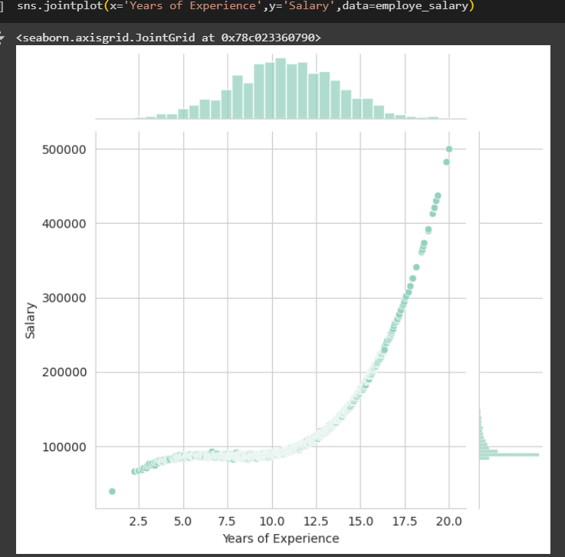
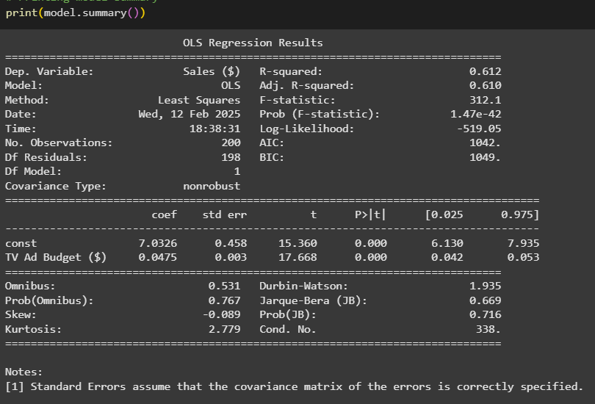
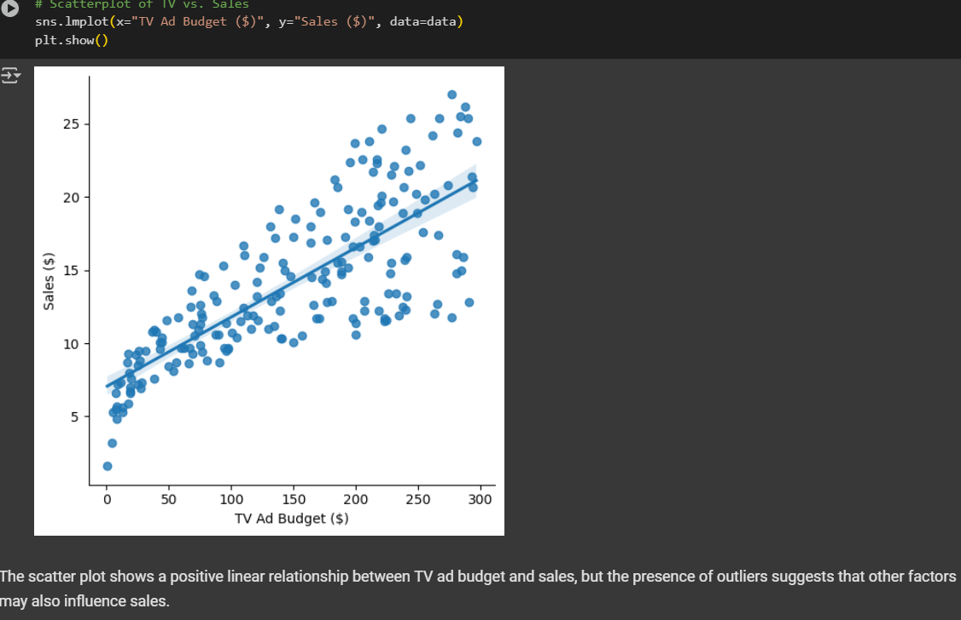
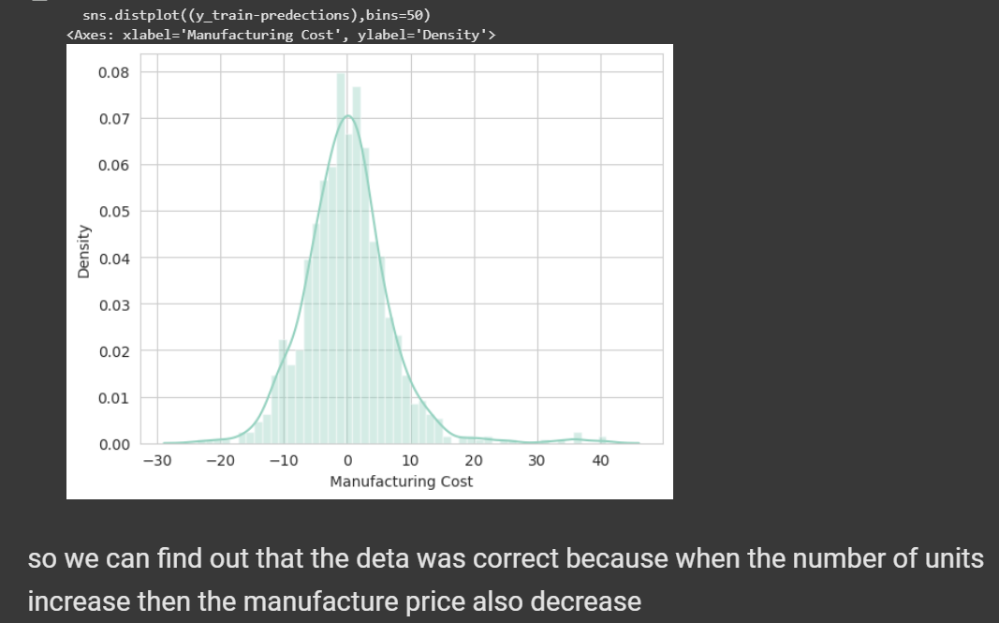
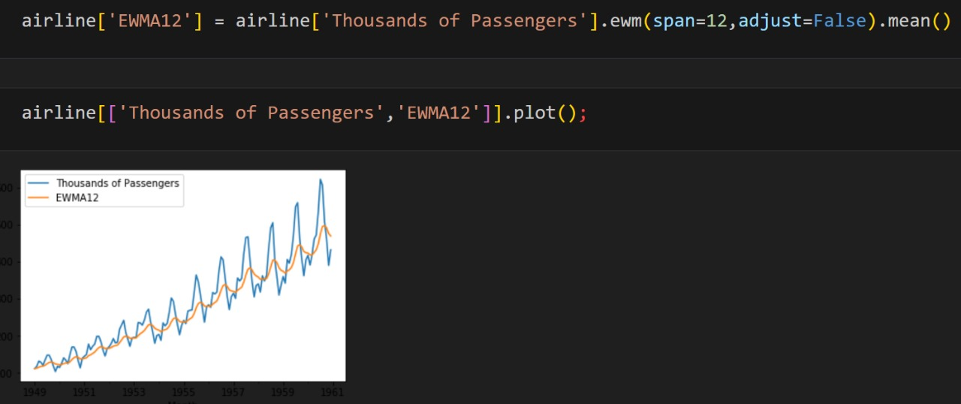
All Analytics at a Glance
Linear Regression
Satistics Model
OLS Statistical Model
Polynomial Regression
EWMA {Exponentially Weighted Moving Average}
(EDA)

Slide 7
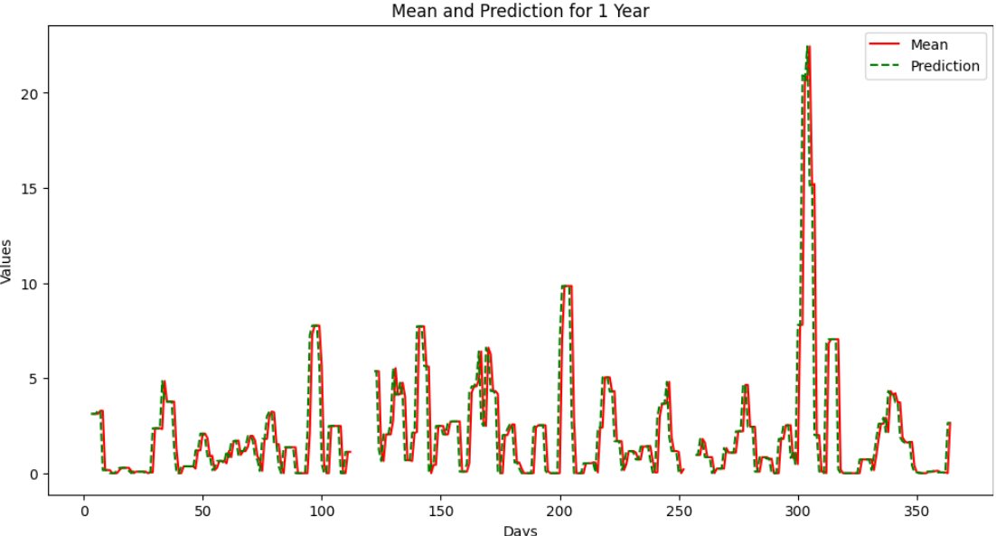


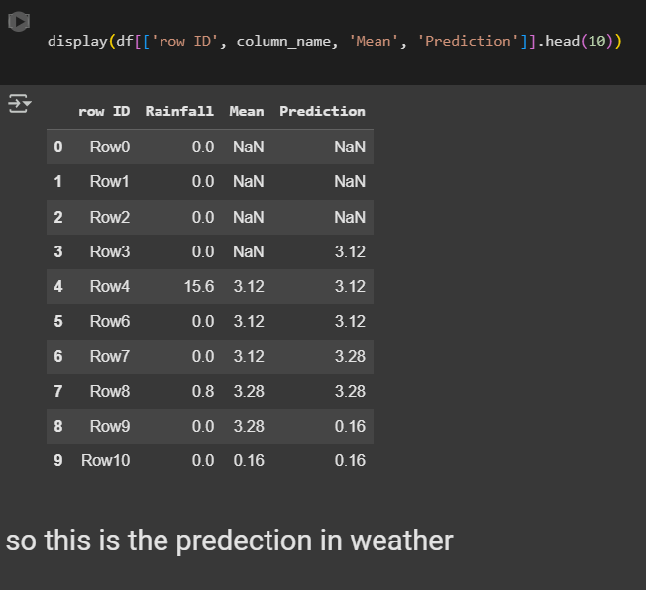

Exponentially Weighted Moving Average(EWMA):
in Feature Engineering and Selection
Smoothing Temporal Data:
EWMA is widely used to smooth time-series data by giving higher weight to recent observations while retaining historical trends, reducing noise and enhancing trend detection in predictive models.
Feature Importance in Anomaly Detection:
By applying EWMA to features, deviations from expected values can be identified, making it useful for detecting anomalies, drifts, or rare events in data streams.
Dimensionality Reduction Aid
EWMA-transformed features can be used to identify the most stable and predictive attributes over time, supporting feature selection by reducing redundant or less informative features.

Slide 8
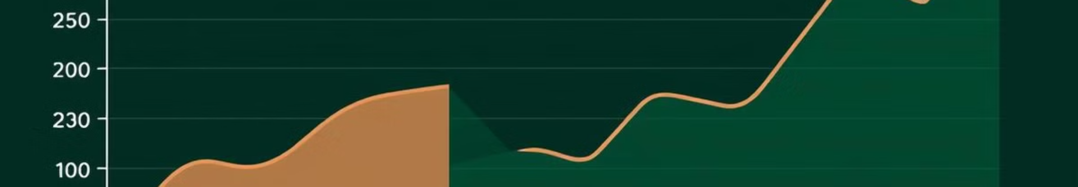



Forecasting Airline Passenger Trends Using Meta Prophet: A Time Series Analysis
Data Preparation
Model Training
Forecasting
Formatting the data for Meta Prophet, including creating 'ds' (date) and 'y’ (No. of Passengers) columns. Ensure the data is structured in a way that the model can easily understand.
Training the Meta Prophet model can be done on historical psssenger data. This involves fitting the model to the time series data and adjusting parameters to optimize performance.
Generating future Seasonality forecasts on passenger travels using the trained model. Extend the model into the future to predict booking and travels plans ahead for upcoming periods.

Slide 9
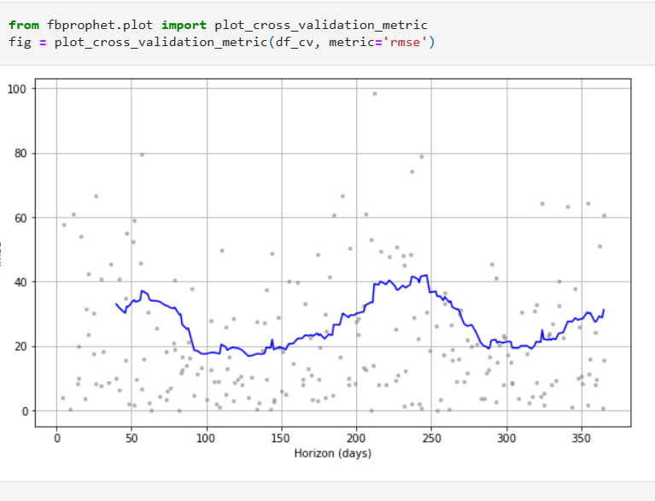
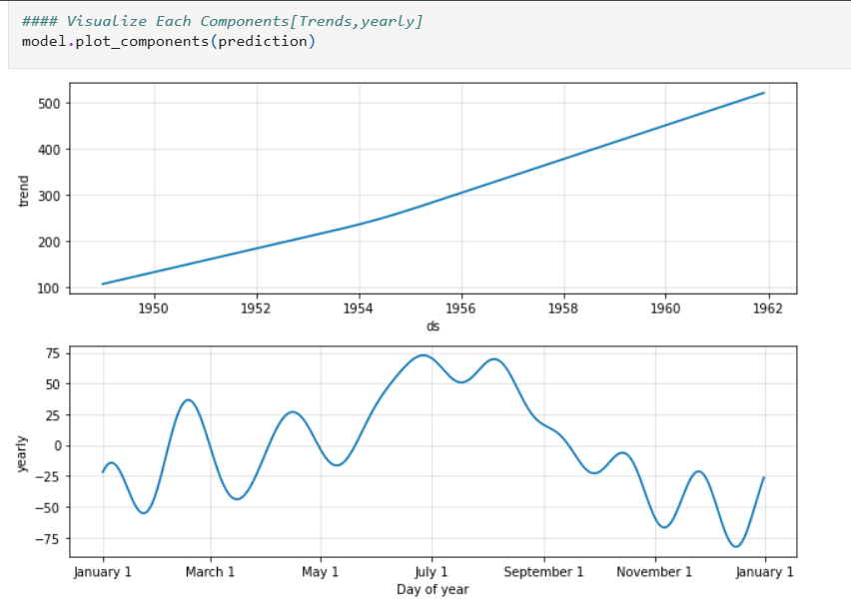
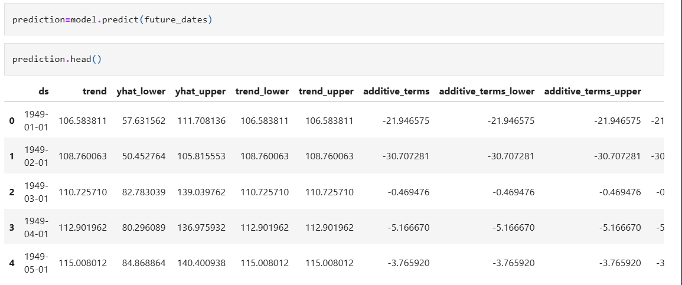
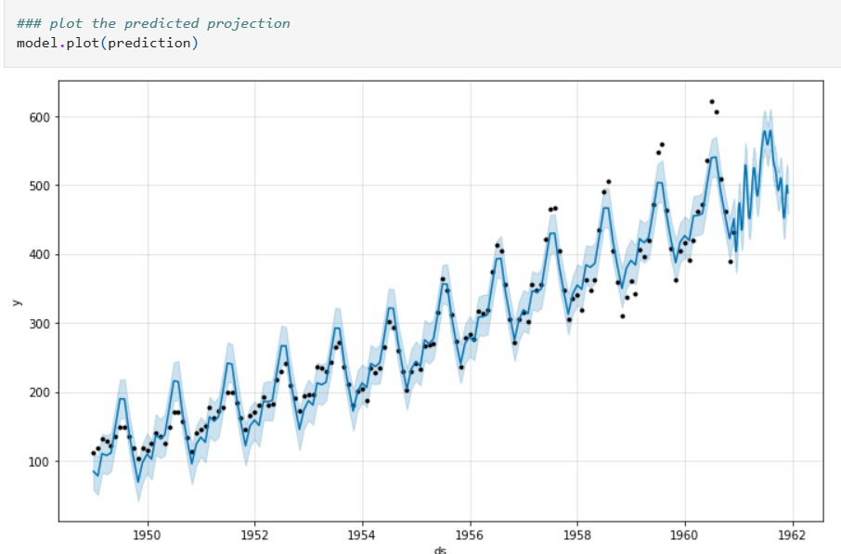
Prophet Dashboard
Cross Validation Metrics
Trends and Yearly Visualisation
Prediction Output: one year ahead.
Prediction Output Plot

Slide 10
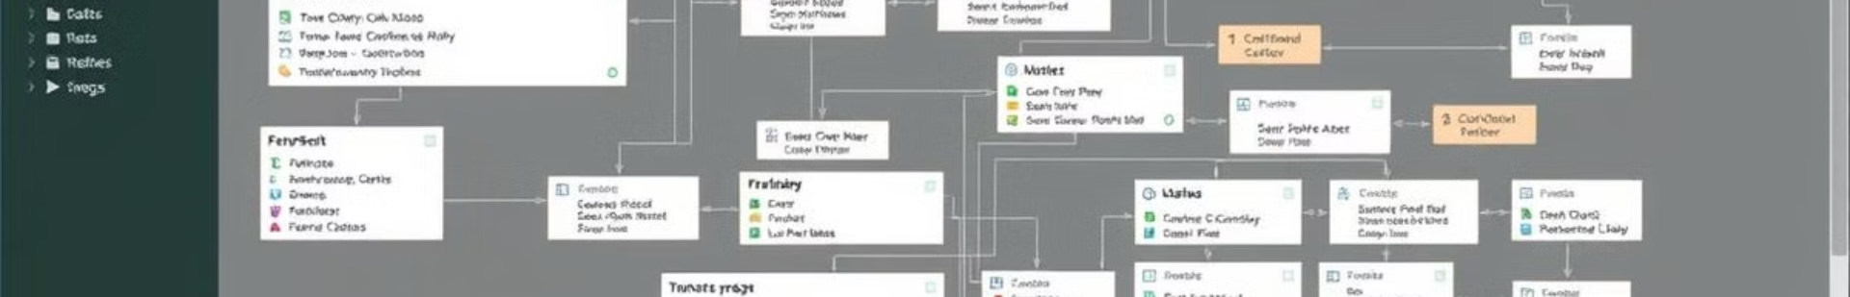
Introduction to KNIME Platform Data Analytics
Overview
1
KNIME is an open-source platform for data analytics, reporting, and integration. It provides a visual workflow environment for designing and executing data science tasks.
2
Key Features
Drag-and-drop interface.
Extensive node library.
Use Cases
3
Integration with various data sources.
Data integration and transformation.
Predictive modeling.
Business intelligence and reporting.

Slide 11

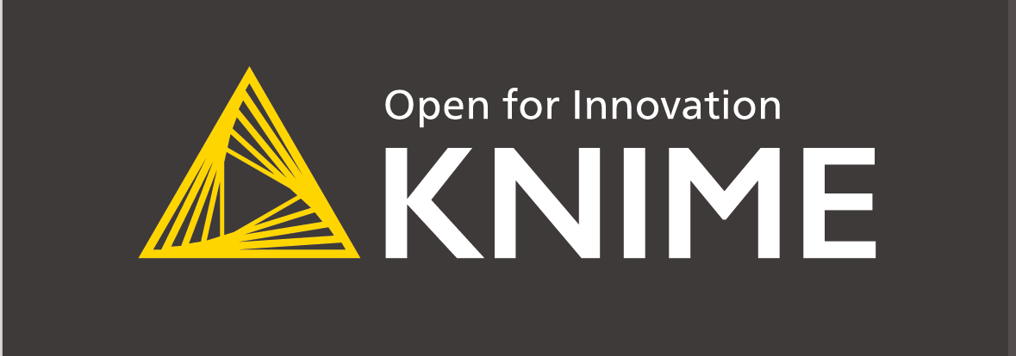
KNIME Workflow: Data Integration and Transformation
1. Data Import & Cleaning
2. Data Information & Transformation
Data Source: Utilizes the Adult dataset from the UCI Machine Learning Repository.
Import Method: Reads data using the File Reader node in KNIME.
Data Cleaning Steps:
Handles missing values by replacing them with the mode or median.
Removes irrelevant columns to streamline the dataset.
Filters out records with inconsistent or erroneous entries.
Data Overview:
Features include age, education, occupation, and hours per week.
Target variable: income category (<=50K or >50K).
Transformations Applied:
Encodes categorical variables using one-hot encoding.
Normalizes numerical features to a standard scale.
Generates new features, such as age groups, to enhance model performance.
3. Insights & Forecasting
Modeling Approach:
Employs a Decision Tree classifier to predict income categories.
Splits data into training and testing sets to evaluate model performance.
Key Insights:
Identifies significant predictors of income, such as education level and occupation.
Visualizes decision paths to understand classification criteria.
Forecasting Capability:
Uses the trained model to predict income categories for new, unseen data.
Assesses model accuracy and refines it for improved future predictions.

Slide 12
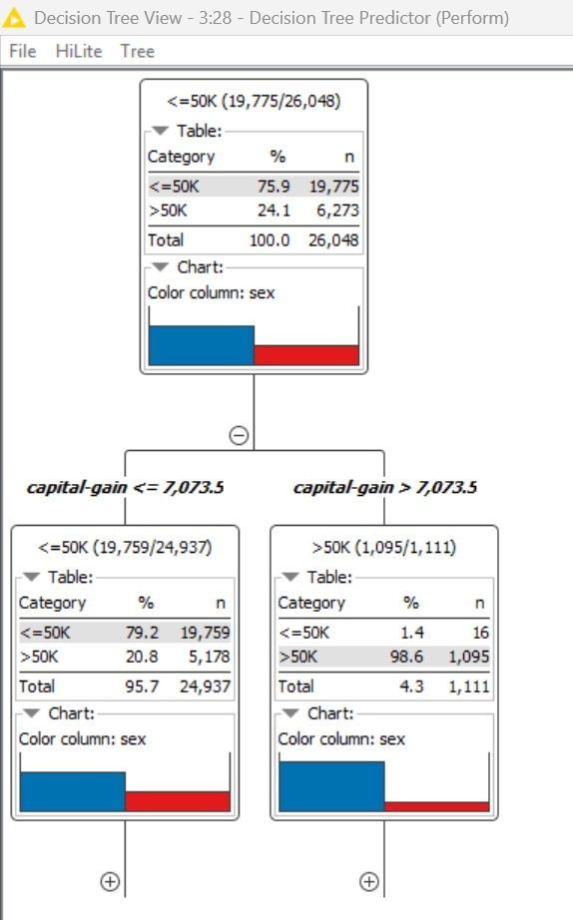
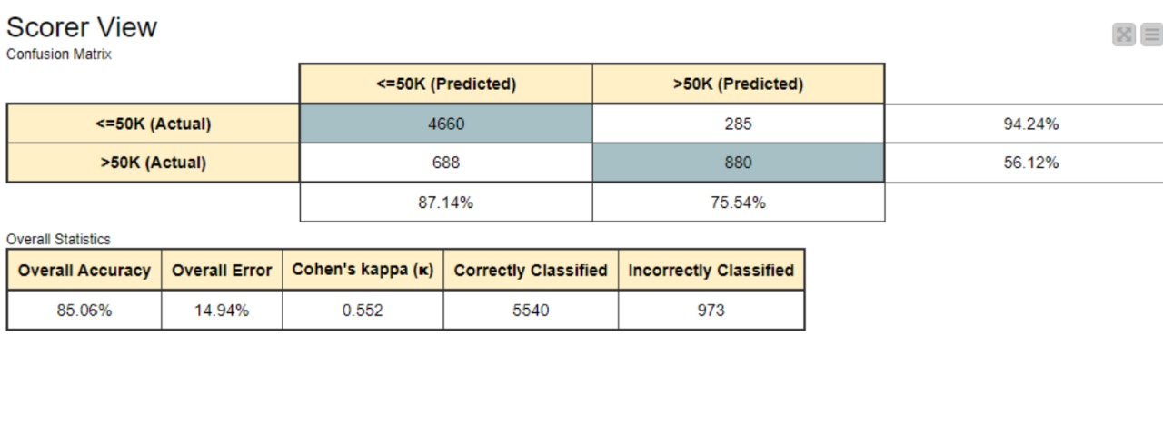
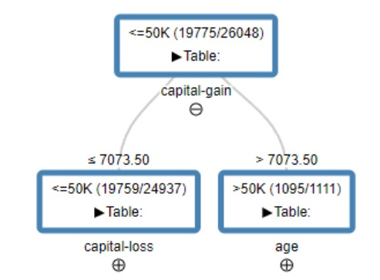
KNIME: Visualizations and Statistics
Scorer Confusion Matrix
A "confusion matrix" in machine learning is a table that visually represents how well a classification model performs by showing the breakdown of correct and incorrect predictions, allowing you to see where the model gets "confused" between different classes, and is used to calculate various metrics like accuracy, precision, and recall to evaluate its performance in details.
Decision Tree View in JS
Decision Tree Learner Output

Slide 13
Conclusion: Results, Insights, and Future Directions
1. Results & Insights
Polynomial Regression & Linear Models: Captured non-linear trends effectively, improving prediction accuracy over standard linear regression.
EWMA (Exponentially Weighted Moving Average): Provided smoothed trend analysis, reducing noise and identifying long-term patterns in time-series data.
The Decision Tree model effectively predicts income categories, with education, occupation, and work hours as key influencing factors.
Model accuracy is satisfactory, but performance can be improved by feature engineering and hyperparameter tuning.
2. Future Directions
Model Optimization: Fine-tuning polynomial degrees, smoothing factors, and regularization techniques for better accuracy.
Hybrid Approaches: Combining EWMA with ML models (like LSTMs or Random Forest) for enhanced time-series forecasting and anomaly detection.
Enhancing Model Performance: Incorporate ensemble learning (Random Forest, Gradient Boosting) to improve predictions.
Expanding Data Scope: Use additional datasets or real-world applications to enhance model generalization and business applicability.

